Slide 1
Camera System Presentation (name TBD)
Dustin Wright
March 8, 2014
San Diego State University

Slide 2
Agenda
Bio
Introduction and Background
Camera System Overview
Video Compression
Video Scaling
System Architecture
Bandwidth Optimization and User Profiles
Experiments
Future Work
Q&A

Slide 3
Speaker Bio
Senior, Majoring in Computer Engineering

Slide 4
Introduction

Slide 5
Video Compression

Slide 6
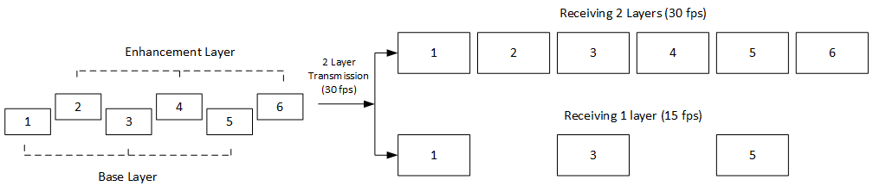
Video Scaling
One method: H.264/SVC
Separate into multiple spatial streams [cite]
Start with one base layer, multiple enhancement layers; each represents a valid bitstream [cite]
Our method: multiple temporal streams

Slide 7
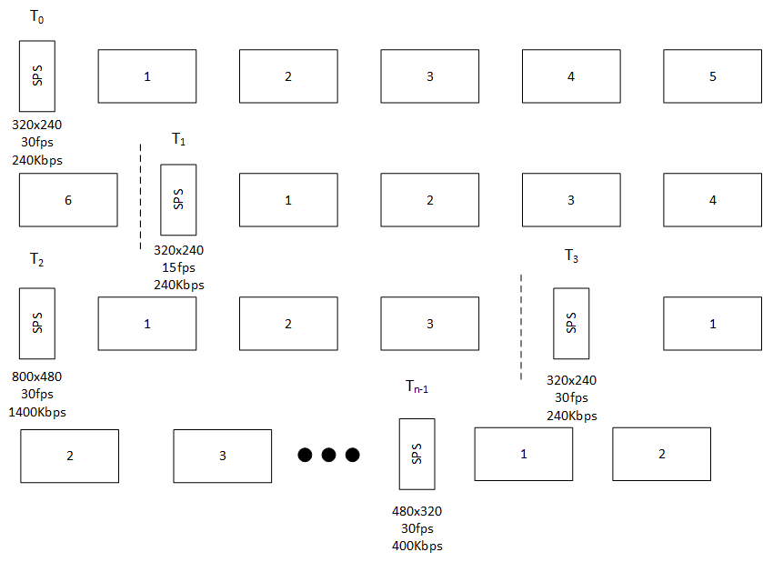
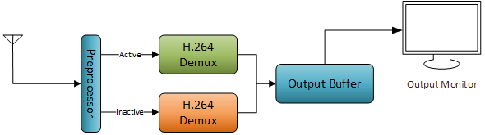
Transmitted Stream
Receiver Architecture

Slide 8
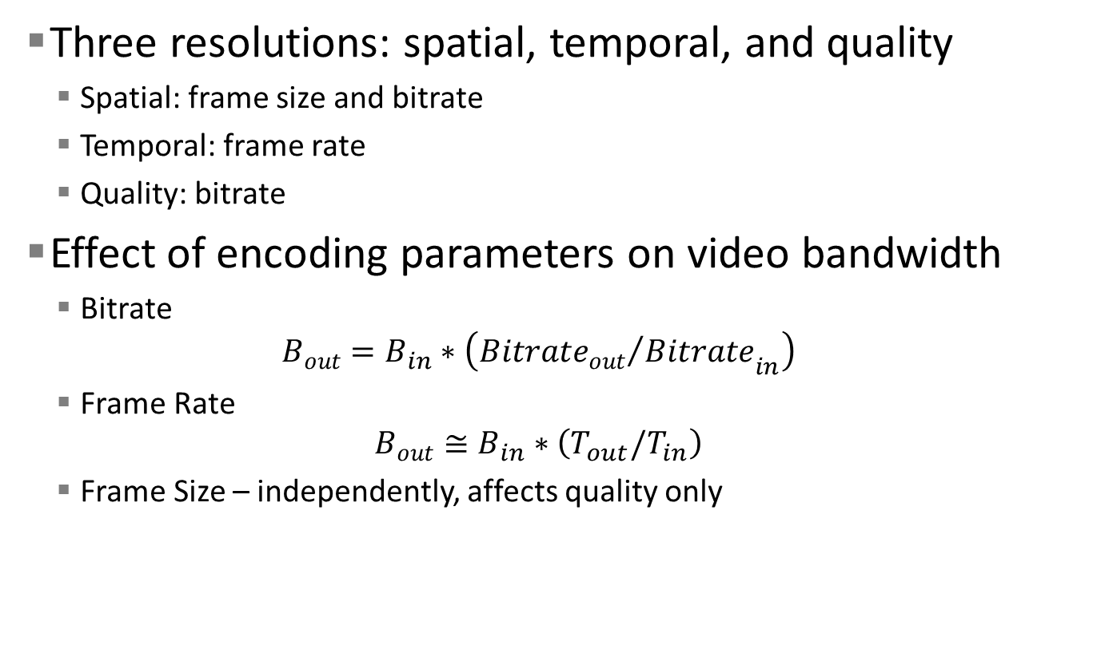
Bandwidth Optimization
Three resolutions: spatial, temporal, and quality
Spatial: frame size and bitrate
Temporal: frame rate
Quality: bitrate
Effect of encoding parameters on video bandwidth
Bitrate
$$B_{out}=B_{in}∗\left({{{Bitrate}_{out}}/{Bitrate}}_{in}\right)$$
Frame Rate
$$B_{out}≅B_{in}∗\left(T_{out}/T_{in}\right)$$
Frame Size – independently, affects quality only

Slide 9
Technologies (TENTATIVE)

Slide 10
System Architecture (TENTATIVE)

Slide 11
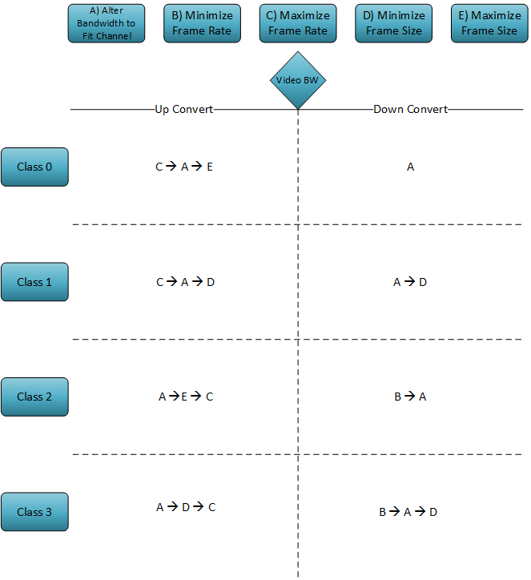
User Profiles and Machine Learning
Classification
4 classes which will determine the user’s preferences
Frame rate vs. bitrate (video bandwidth)
Size vs. quality (quality)
Use two support vector machines
Develop a training set as user
makes scaling decisions
Train the SVMs, determine user’s
class
Determine if bandwidth should be
increased or decreased

Slide 12
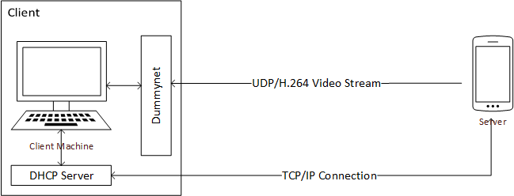
Experimental Setup
Test Cases
Bandwidth control with spatial resolution
Bandwidth control with quality resolution
Intelligent decisions using user profiles

Slide 13
Experimental Results

Slide 14
Future Work

Slide 15
Acknowledgements

Slide 16
Questions?

